Slide 1
THE AUTONOMIC NERVOUS SYSTEM
(ANS)
Al-Farabi Kazakh National University
Higher School of Medicine

Slide 2
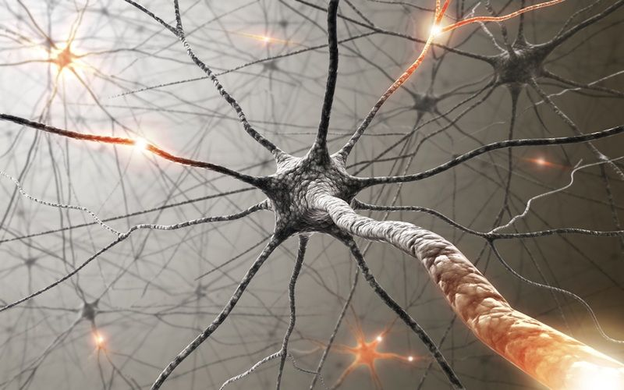
THE AUTONOMIC NERVOUS SYSTEM (ANS)
Brief Content of Lesson:
General Properties of the Autonomic Nervous System
Divisions of the Autonomic Nervous System
Autonomic Output Pathways
Anatomy of the Autonomic Nervous System
Sympathetic & Parasympathetic divisions
Adrenal Glands
Enteric nervous system
Autonomic Effects on Target Organs
Neurotransmitters and Their Receptors
Dual Innervation
Control Without Dual Innervation
Central Control of Autonomic Function
Objectives:
Distinguish between somatic and autonomic reflexes.
Define the autonomic nervous system, and compare its anatomy with that of the somatic motor division of the peripheral nervous system.
Compare and contrast the sympathetic and parasympathetic divisions of the autonomic nervous system.

Slide 3
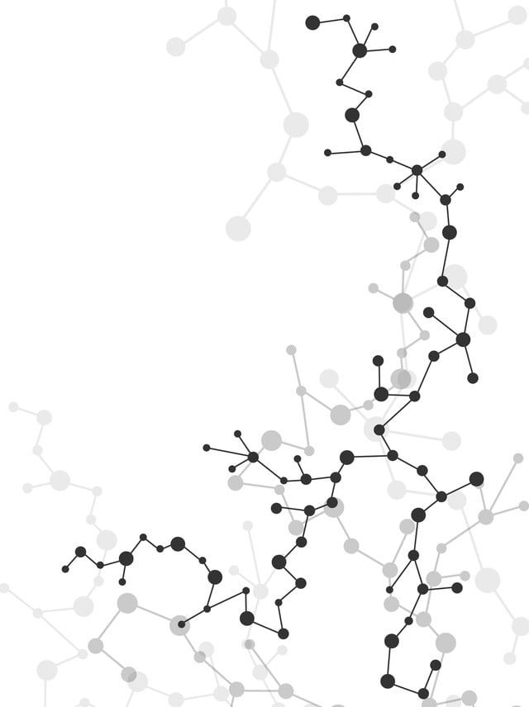
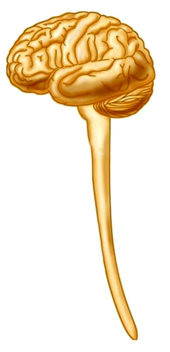
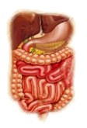
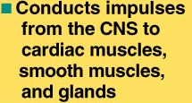
THE AUTONOMIC NERVOUS SYSTEM (ANS)
Precentral gyrus of cerebrum
Postcentral gyrus of cerebrum
Thalamus
Hypo-
thalamus
Cerebe- llum
Sensory (afferent) Division
Autonomic Nervous System
Autonomic ganglion
Somatic sensory receptors
Visceral sensory receptors

Slide 4
THE AUTONOMIC NERVOUS SYSTEM (ANS)
The Autonomic Nervous System (ANS) can be defined as a motor nervous system that controls glands, cardiac muscle, and smooth muscle.
The ANS works through visceral reflexes, which regulate such primitive functions as blood pressure, heart rate, body temperature, digestion, and many others.
Notes:
The autonomic nervous system is a division of the nervous system that regulates the activity of internal organs, glands of internal and external secretion, blood and lymphatic vessels. Plays a leading role in maintaining the constancy of the internal environment of the body and in the adaptive reactions of all vertebrates.
In short, the ANS quietly manages a myriad of unconscious processes responsible for our homeostasis; these are not specifically human but among our most basic animal functions.
Many drug therapies are based on manipulation of autonomic functions.

Slide 5
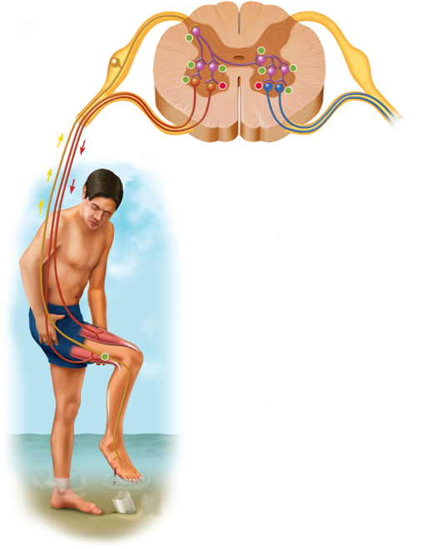
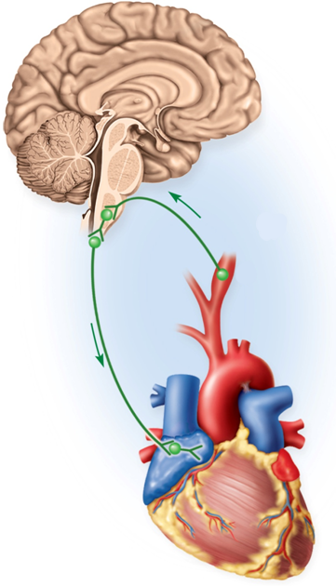
THE AUTONOMIC NERVOUS SYSTEM (ANS)
The ANS is responsible of the Visceral Reflexes
Reflex:
It is a rapid involuntary response triggered by the CNS for the purpose of maintaining homeostasis.
1) Somatic Reflex:
It is a reflex resulting in the contraction of an skeletal muscles.
2) Autonomic or Visceral Reflex:
It is an unconscious, automatic, stereotyped responses to stimulation involving visceral receptors and the response of visceral effectors (contraction of cardiac muscle, smooth muscle or in the secretion of glands).
For example, high blood pressure is controlled by a baroreflex.
2
Glossopharyngeal nerve transmits signals to medulla oblongata (brain stem)
1
Baroreceptors sense increased blood pressure
BP
3
Vagus nerve transmits
Inhibitory signals to cardiac pacemaker
4
Heart rate decreases reducing blood pressure
BP

Slide 6
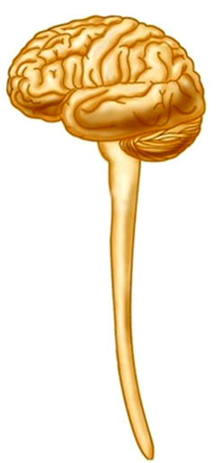
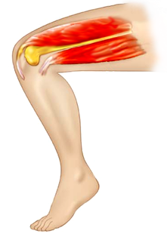
Autonomic Output Pathways
Upper motor neuron in precentral gyrus of cerebrum
Somatic Nervous System:
1- The entire distance from the CNS (spinal cord) to the effector is spanned by one neuron.
2- Only acetylcholine is employed as neurotransmitter.
Lower motor neuron in anterior gray horn of spinal cord
Myelinated fiber
Acetylcholine
CNS
Somatic effectors
(skeletal muscles)
Autonomic Nervous System:
1- The entire distance from the CNS spinal cord) to the effector is spanned by two neurons.
2- Only acetylcholine is employed as neurotransmitter in the preganglionic neuron, but postganglionic neurons can employ either acetylcholine or norepinephrine.
Postganglionic neuron
Acetylcholine or Norepinephrine
Acetylcholine
Preganglionic neuron
Autonomic ganglion
Notes:
Autonomic Output Pathways
The autonomic motor pathway to a target organ differs significantly from somatic motor pathways.
In somatic pathways, a motor neuron in the brainstem or spinal cord issues a myelinated axon that reaches all the way to a skeletal muscle.
In autonomic pathways, the signal must travel across two nerve fibers to get to the target organ, and it must cross a synapse where these two neurons meet in an autonomic ganglion

Slide 7
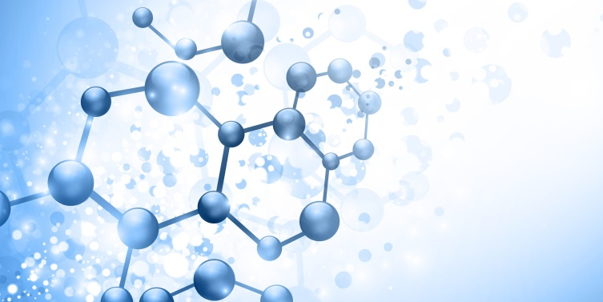
General Properties of the Autonomic Nervous System
The heart beats at its own intrinsic rate of about 100 beats/min. The parasympathetic tone holds the resting heart rate down to about 70 to 80 beats/min.
Denervation hypersensitivity : It is an exaggerated response of cardiac and smooth muscle if autonomic nerves are severed damaged.

Slide 8
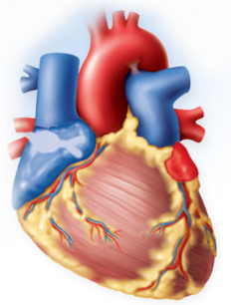
Anatomy of the Autonomic Nervous System
The ANS has two divisions. Both divisions innervate the same target organs
1- The Sympathetic
Division
2- The Parasympathetic
Division
It adapts the body for physical activities: exercise, trauma, arousal, competition, anger, or fear
(fight or fly). It increases:
It has a calming effect on many body functions reducing energy expenditure and assists in bodily maintenance. It reduces:
1- Alertness, 2- heart rate, 3- blood pressure, 4- pulmonary airflow,
5- blood glucose concentration,
6- blood flow to cardiac and skeletal muscle.
1- Alertness, 2- heart rate, 3- blood pressure, 4- pulmonary airflow,
5- blood glucose concentration,
6- blood flow to cardiac and skeletal muscle.
It reduces the activity of:
1- Digestive system
2- Urinary system
It increases the activity of:
1- Digestive system
2- Urinary system
The two divisions innervate same target organs, and are active simultaneously, producing an autonomic tone.
Sympathetic tone
Heart rate
Autonomic tone
Parasympathetic tone
Heart rate

Slide 9
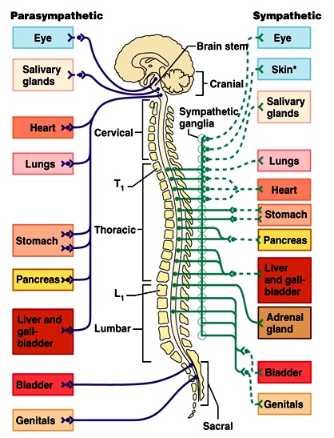
Anatomy of the Autonomic Nervous System
Divisions of the ANS
Parasympathetic
Sympathetic
Craniosacral outflow: Brain-stem nuclei of cranial nerves III, VII, IX and X; and spinal cord S2-S4
Thoracolumbar outflow: Lateral horns of gray matter of spinal cord segments T1- L2
Ganglia in (intramural) or close to the visceral organ served
Ganglia within a few centimeters from the CNS: alongside and anterior to the vertebral column
Long preganglionic; short postganglionic fibers
Short preganglionic; long postganglionic fibers
Maintenance functions; conserves and stores energy
Prepares body for activity
All fibers releases ACh (cholinergic fibers)
All preganglionic fibers release Ach; most postganglionic fibers release Norepinephrine (adrenergic fibers)
Notes:
Parasympathetic fibers leave the brainstem in the following
cranial nerves. The first three supply all parasympathetic innervation
to the head, and the last one supplies viscera of the thoracic
and abdominopelvic cavities.
1. Oculomotor nerve (III). The oculomotor nerve carries
parasympathetic fibers that control the lens and pupil of the
eye. The preganglionic fibers enter the orbit and terminate in
the ciliary ganglion behind the eyeball. Postganglionic fibers
enter the eyeball and innervate the ciliary muscle, which
thickens the lens, and the pupillary constrictor, which narrows
the pupil.
2. Facial nerve (VII). The facial nerve carries parasympathetic
fibers that regulate the tear glands, salivary glands, and nasal
glands. Soon after the facial nerve emerges from the pons,
its parasympathetic fibers split away and form two smaller
branches. The superior branch ends at the pterygopalatine
ganglion near the junction of the maxilla and palatine bone.
Postganglionic fibers then continue to the tear glands and
glands of the nasal cavity, palate, and other areas of the oral
cavity. The inferior branch crosses the middle-ear cavity and
ends at the submandibular ganglion near the angle of the
mandible. Postganglionic fibers from here supply salivary
glands in the floor of the mouth.
3. Glossopharyngeal nerve (IX). The glossopharyngeal nerve
also carries parasympathetic fibers concerned with salivation.
The preganglionic fibers leave this nerve soon after its
origin and form the tympanic nerve. This nerve crosses the
middle-ear cavity and ends in the otic10 ganglion near the
foramen ovale. The postganglionic fibers then follow the
trigeminal nerve to the parotid salivary gland just in front of
the earlobe.
4. Vagus nerve (X). The vagus nerve carries about 90% of
all parasympathetic preganglionic fibers. It travels down
the neck and forms three networks in the mediastinum of
the chest—the cardiac plexus, which supplies fibers to the
heart; the pulmonary plexus, whose fibers accompany the
bronchi and blood vessels into the lungs; and the esophageal
plexus, whose fibers regulate swallowing.

Slide 10
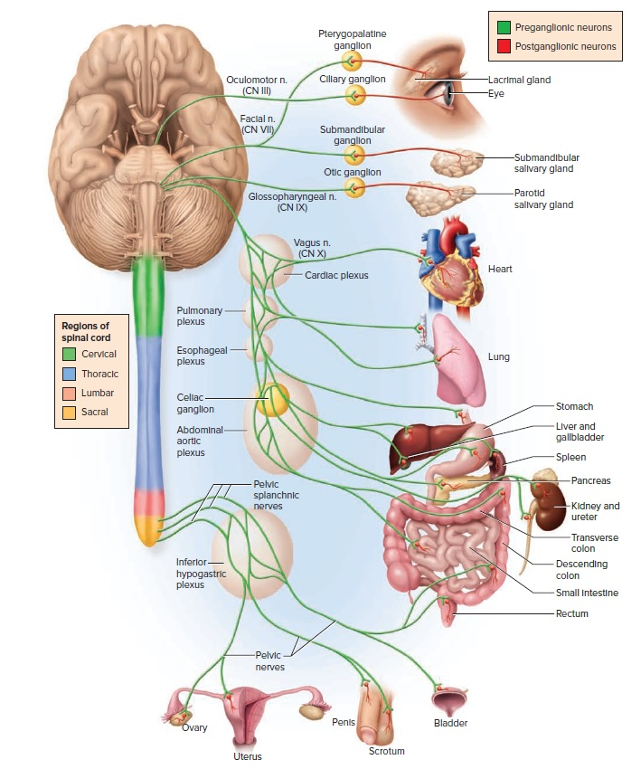
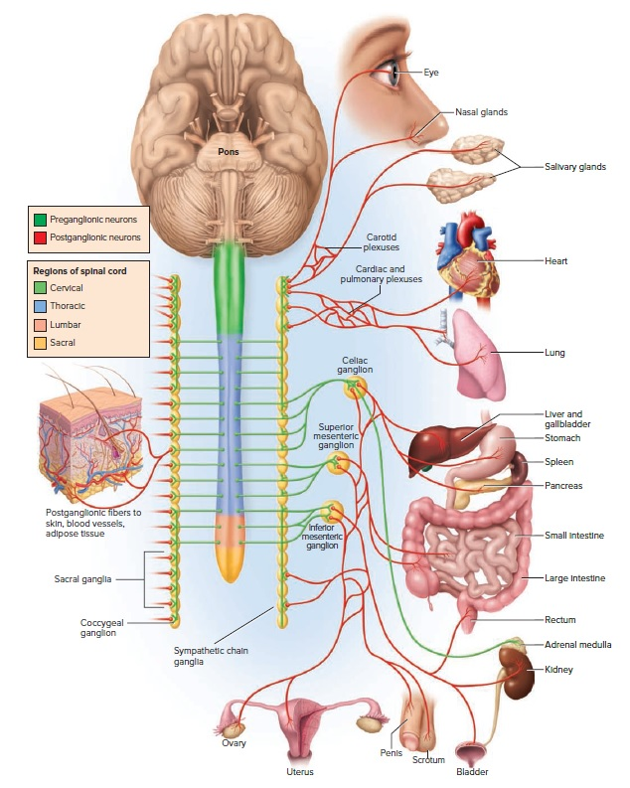
Anatomy of the Autonomic Nervous System
Parasympathetic
Sympathetic
Notes:
The Sympathetic division
All nerve fibers of the sympathetic division arise from the thoracic and lumbar regions of the spinal cord; hence, this system is also called the thoracolumbar division.
The Parasympathetic division
The parasympathetic division is also called the craniosacral division because its nerve fibers arise from the brain and sacral region of the spinal cord; they travel in certain cranial and sacral nerves.

Slide 11
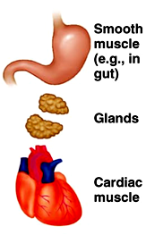
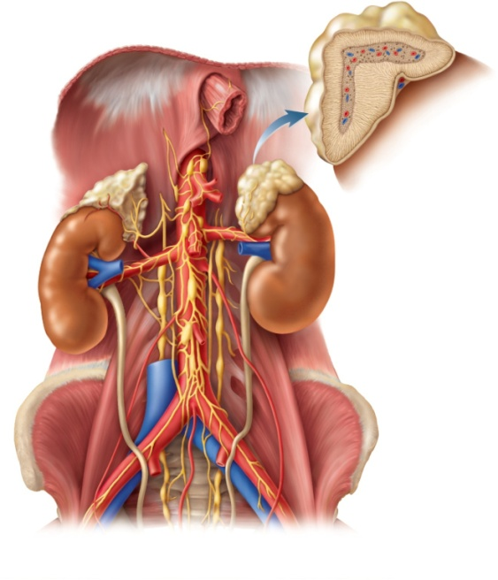
Anatomy of the Autonomic Nervous System
The Adrenal Glands
The adrenal medulla secretes a mixture of hormones into bloodstream called catecholamines:
Effector organs
Adrenal cortex
Adrenal medulla
85% epinephrine (adrenaline)
15% norepinephrine (noradrenaline).
Those hormones also function as neurotransmitters of the Sympathetic Division.
Notes:
The Adrenal Glands
The paired adrenal (suprarenal) glands rest like hats on the superior poles of the kidneys. The outer rind, the adrenal cortex, secretes steroid hormones. The inner core, the adrenal medulla, is essentially a sympathetic ganglion. It consists of modified postganglionic neurons without dendrites or axons. Sympathetic preganglionic fibers penetrate through the cortex and terminate on these cells.
When stimulated, the adrenal medulla secretes a mixture of hormones into the bloodstream—about 85% epinephrine (adrenaline), 15% norepinephrine (noradrenaline), and a trace of dopamine. These hormones, the catecholamines.

Slide 12
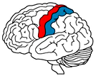
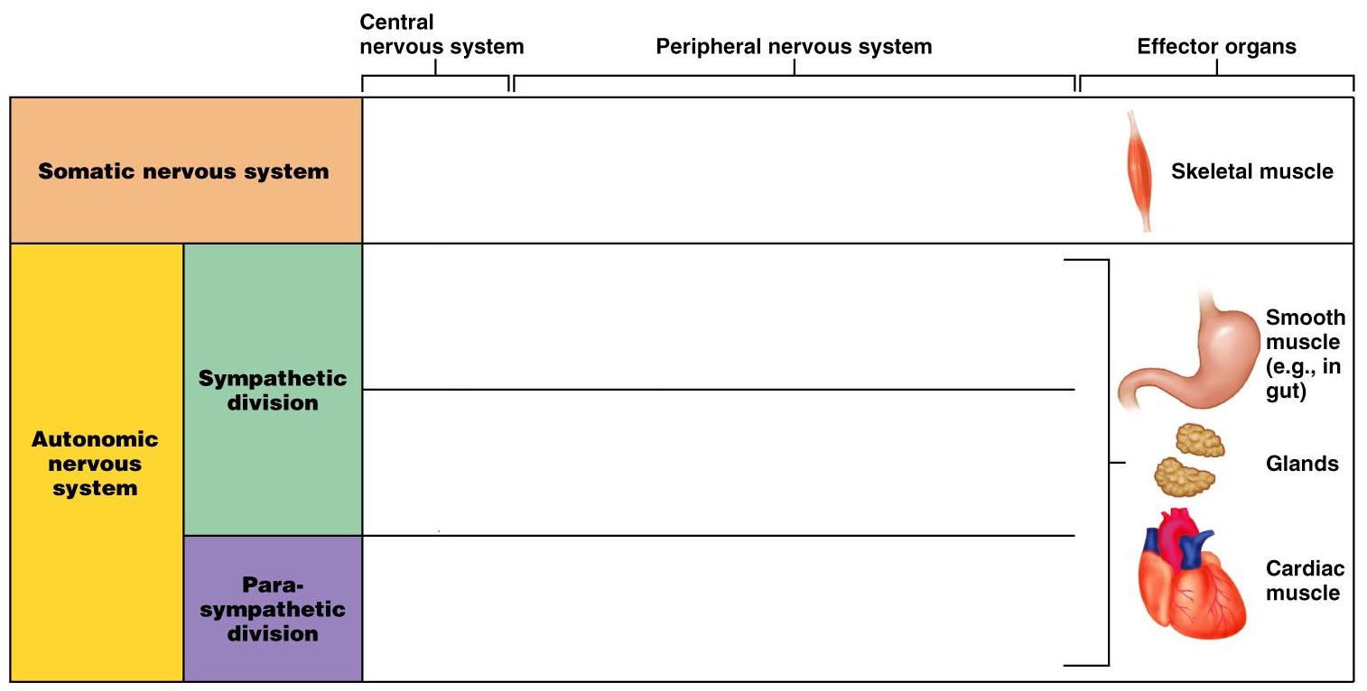
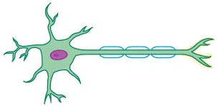
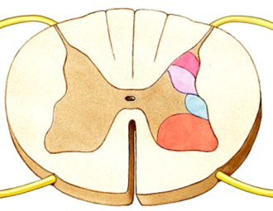
Comparison of Somatic and Autonomic Nervous System
Precentral gyrus
Acetylcholine
Acetylcholine
Norepinephrine
Ganglion
Hypothalamus
Epinephrine & Norepinephrine
Acetylcholine
Adrenal medulla
Acetylcholine
Acetylcholine
Ganglion
Visceral motor
Somatic motor

Slide 13
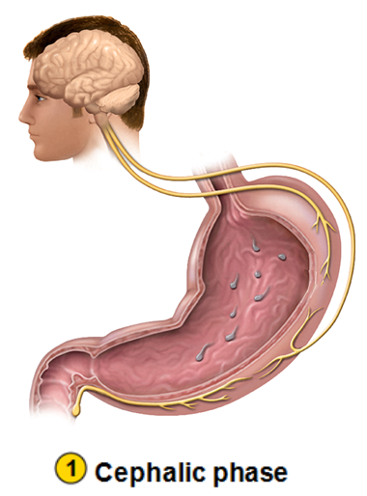
Anatomy of the Autonomic Nervous System
The Enteric Nervous System
The digestive tract has a nervous system of its own called the enteric nervous system.
Regulation of Gastric Activity by Autonomic or Visceral Reflexes
Stimuli:
The nervous and endocrine systems collaborate to increase gastric secretion and motility when food is eaten and to suppress them when the stomach empties.
Sight, smell, taste, or thought of food
CNS
Cephalic Phase of Gastric Activity
Vagus nerve (parasympathetic) stimulates gastric secretion even before food is swallowed.
Vagus nerve
Parasympathetic division
The Cephalic Phase is directed by the CNS and prepares the stomach to receive food.
ACh
+
Mucous cells
Mucus
Chief cells
Pepsinogen
Parietal cells
HCl
Notes:
The digestive tract has a nervous system of its own called the enteric nervous system. Unlike the ANS proper, it does not arise from the brainstem or spinal cord, but like the ANS, it innervates smooth muscle and glands. Thus, opinions differ on whether it should be considered part of the ANS. The enteric nervous system regulates the motility of the esophagus, stomach, and intestines and the secretion of digestive enzymes and acid. To function normally, however, these digestive activities also require regulation by the sympathetic and parasympathetic systems.

Slide 14
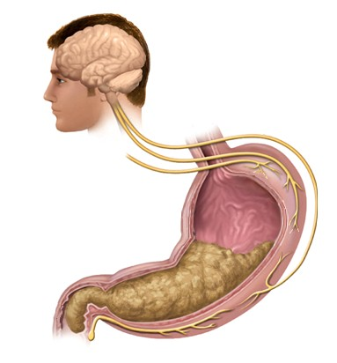
Anatomy of the Autonomic Nervous System
Intestinal Phase of Gastric Activity
It begins when chyme first enters the duodenum.
Stimuli:
Distention of the duodenum by the chyme.
Decrease in the pH of the duodenum by the chyme.
Response:
_
Stretch receptors and chemoreceptors in the duodenum trigger the Enterogastric Reflex.
Sympathetic nerve
The medulla oblongata stimulates sympathetic neurons that send inhibitory signals to the stomach.
Mucous cells
X
Mucus
The net result is that immediately after the chyme enters the duodenum, gastric contractions decrease, and further discharge of chyme is prevented, giving the duodenum time to neutralize and digest the acidic chyme.
X
Chief cells
Pepsinogen
Parietal cells
X
HCl

Slide 15
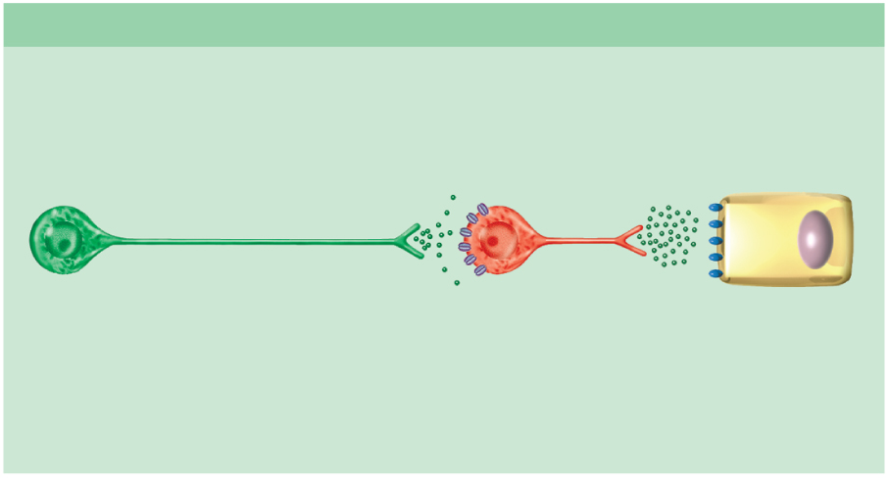
Autonomic Effects on Target Organs
Neurotransmitters and Their Receptors
(a) Parasympathetic fiber
Nicotinic
receptor
+ Ach is always excitatory
ACh
Ganglion
Target
cell
ACh
Preganglionic
neuron
Postganglionic
neuron
Muscarinic
receptor
+ Ach may be excitatory (digestive system) or inhibitory (heart)

Slide 16
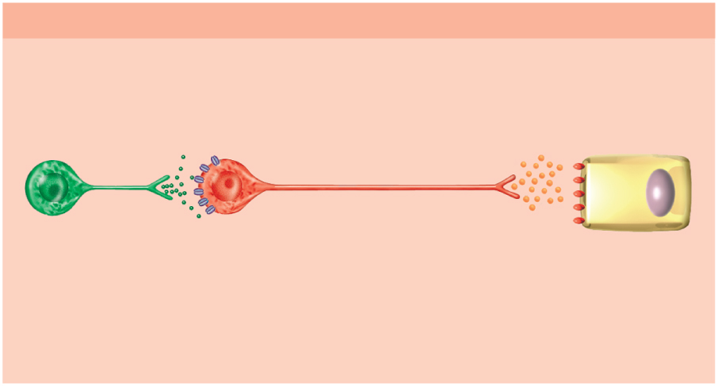
Autonomic Effects on Target Organs
Neurotransmitters and Their Receptors
(b) Sympathetic adrenergic fiber
Nicotinic
receptor
+ Ach is always excitatory
Norepinephrine(NE)
ACh
Ganglion
Target
cell
Preganglionic
neuron
Adrenergic receptor
Postganglionic
neuron
a- adrenergic receptor :
They usually have excitatory effects (labor contractions)
b- adrenergic receptor :
They usually have inhibitory effects (relaxation of bronchioles)

Slide 17
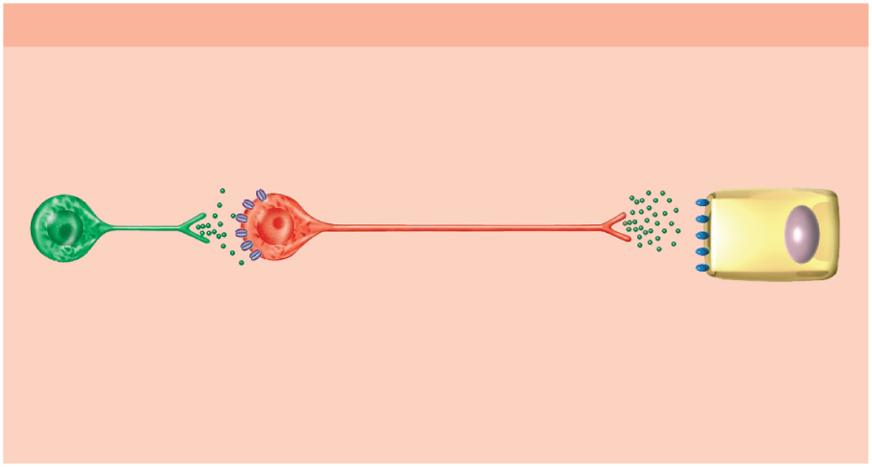
Autonomic Effects on Target Organs
Neurotransmitters and Their Receptors
(c) Sympathetic cholinergic fiber
Nicotinic
receptor
+ Ach is always excitatory
ACh
Ganglion
Target
cell
Preganglionic
neuron
ACh
Postganglionic
neuron
Muscarinic receptor

Slide 18
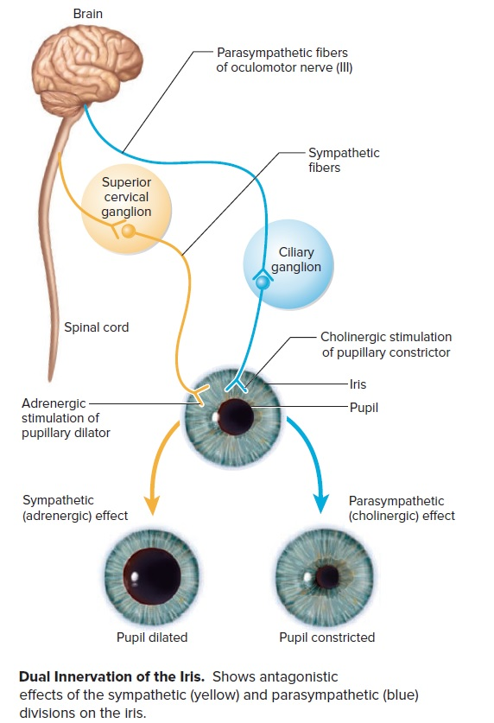
Autonomic Effects on Target Organs
Dual Innervation
Most of the viscera receive nerve fibers from both the sympathetic and parasympathetic divisions and thus are said to have dual innervation. In such cases, the two divisions may have either antagonistic or cooperative effects on the same organ.

Slide 19
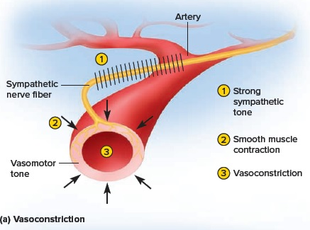
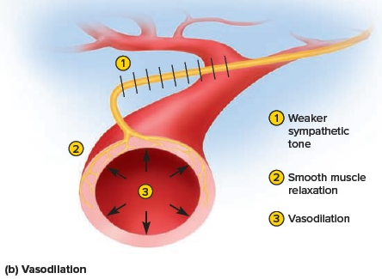
Autonomic Effects on Target Organs
Control Without Dual Innervation
Dual innervation is not always necessary for the ANS to produce opposite effects on an organ. The adrenal medulla, piloerector muscles, sweat glands, and many blood vessels receive only sympathetic fibers.

Slide 20
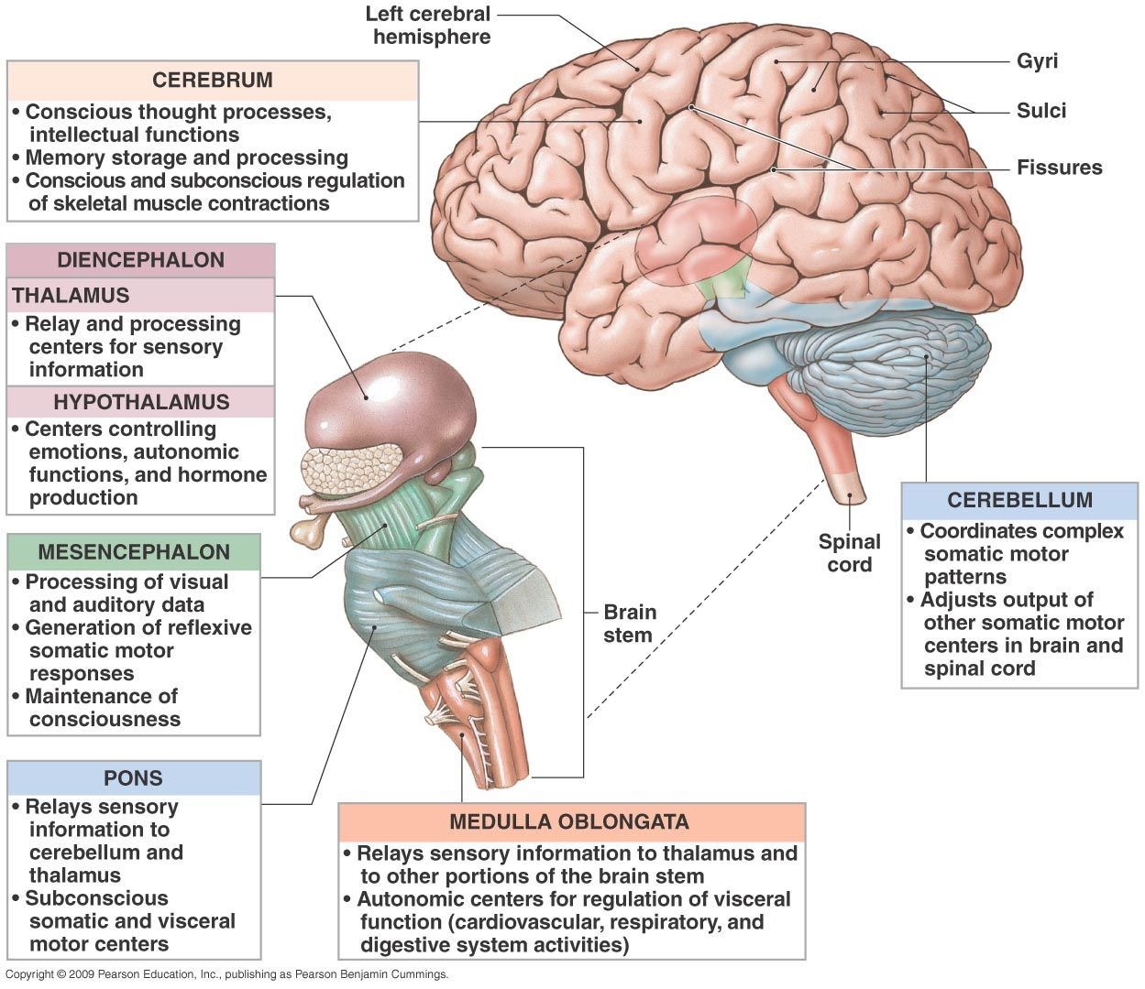
Autonomic Effects on Target Organs
Central Control of Autonomic Function
Cerebral cortex
Hypothalamus
Midbrain, pons, and medulla oblongata
Spinal cord

Slide 21
Thanks for your attention!

